Slide 1
ANNOUNCEMENTS today is No Laptop Monday! 🙅‍♂️💻🎉 WARMUP (discuss with people you don't know) what does 2 + 2 like...mean? 🧠 🌞 TODAY Fundamentals of Java Part 1

Slide 2
thank you to those who emailed DrJava questions! note: my email responses tend to be really short; it doesn't mean i'm annoyed; i just have to write emails really fast because there are ~64 students in this class 🙂👍 ps screenshots are really helpful if you email me!

Slide 3
is there anyone here who is not yet enrolled in CS 136 and would like to be?

Slide 4
questions before we begin?

Slide 5
record lecture?

Slide 6
built-in data types

Slide 7
primitive data types

Slide 8
boolean, char, double, int
a boolean stores a truth value
true, false
a char stores a character
'\0', 'a', 'Z', '!', '\n'
a double stores a floating point number
0.0, -0.5, 3.1415926, Double.NEGATIVE_INFINITY
an int stores an integer number
0, -1, 4

Slide 9
primitive data type Venn diagram
integers
numbers
char
double
boolean
int

Slide 10
char is an integer type
a char is an integer type
each char has a corresponding integer, for example ('a' == 97)
the letters are in order ('a' == 97), ('b' == 98), ('c' == 99)...
the numbers are also in order ('0' == 48), ('1' == 49)...
you can do math with char's
char foo = 'a' + 2; // foo is 'c'
char bar = '0' + 7; // bar is '7'
int baz = '6' - '0'; // baz is 6

Slide 11
zero
each primitive data type has its own notion of what it means to "be zero"
int zero = 0;
double zero = 0.0;
boolean zero = false;
char zero = '\0'; // the "null character"

Slide 12
String

Slide 13
String (1/2)
a String is a sequence of characters
"Hello World", "Foo123"

Slide 14
String (2/2)
String's have several useful functions/methods (which are described in our Documentation)
String string = "Hello"; // makes a new String
System.out.println(string.length()); // 5
System.out.println(string.charAt(1)); // 'e'
System.out.println(string.substring(0, 3)); // "Hel"

Slide 15
operators (except for bitwise operators, which we'll do later maybe)

Slide 16
assignment operator

Slide 17
assignment operator
= assigns the value on the right-hand side to the variable on the left-hand side
int i = 0; // 0 ("int i now has the value 0")
double foo = coolFunction();
☠ the assignment operator returns the value it assigned this is usually pretty confusing
boolean b = false;
boolean c = (b = foo());

Slide 18
arithmetic operators

Slide 19
basic arithmetic (number) operators
+ adds two numbers
- subtracts two numbers
* multiplies two numbers
/ divides two numbers
☠ an int divided by an int is an int
int foo = 8 / 2; // 4
int bar = 7 / 2; // 3
Java "throws away the remainder"
- returns the negative of a number
int bar = -7; // -7 ("negative 7" or "minus 7")
int baz = -bar; // 7

Slide 20
modulo
x % N returns the remainder of (x / N) and is read "x modulo N"
int foo = 17 % 5; // 2 ("17 divided by 5 is 3 remainder 2")
☠ % probably doesn't do what you expect for negative numbers; instead, use floorMod
5 % 3 // 2
4 % 3 // 1
3 % 3 // 0
2 % 3 // 2
1 % 3 // 1
0 % 3 // 0
-1 % 3 // -1 🤔
Math.floorMod(-1, 3) // 2 🙂👍

Slide 21
logical operators

Slide 22
logical operators (1/2)
|| returns whether the left-hand side or the right-hand side is true
(true || true) // true
(true || false) // true
(false || true) // true
(false || false) // false
&& returns whether the left-hand side and the right-hand side are true
(true && true) // true
(true && false) // false
(false && true) // false
(false && false) // false
! returns the opposite of a boolean, and is read as "not"
(!true) // false ("not true")
(!false) // true

Slide 23
logical operators (2/2)
// example, step by step
boolean a = (2 + 2 == 5); // false
boolean b = true; // true
boolean c = (a || b); // true
boolean d = !c; // false
// same thing all on one line
boolean d = !((2 + 2 == 5) || true); // false
// equivalent code
boolean d = false;

Slide 24
☠ logical operator short-circuiting
(false && foo()) "lazily" evaluates to false without evaluating foo()
(true || foo()) "lazily" evaluates to true without evaluating foo()

Slide 25
comparison operators

Slide 26
☠ equality (is equal to)
== returns whether the left-hand side is equal to the right-hand side
boolean b = (foo == bar);
if (foo == bar) { ... }
☠ this does NOT work for String's
instead, use (stringA.equals(stringB) )
☠ this (usually) does NOT work for double's
instead, use (Math.abs(double1 - double2) < 0.00001)

Slide 27
is greater than, is less than
> returns whether the left-hand side is greater than the right-hand side
< returns whether the left-hand side is less than the right-hand side

Slide 28
convenient operators (feel free to ignore these for now)

Slide 29
inequality
!= returns whether the left-hand side is not equal to the right-hand side
(left != right) is exactly the same as (!(left == right))

Slide 30
greater than or equal to, less than or equal to
>= returns whether the left-hand side is greater than or equal to the right-hand side
(left >= right) is basically the same as ((left > right) || (left == right)) greater-than or equal
<= returns whether the left-hand side is less than or equal to the right-hand side

Slide 31
arithmetic assignment operators
a += b; // a = a + b;
a -= b; // a = a - b;
a *= b; // a = a * b;
a /= b; // a = a / b;

Slide 32
String concatenation
+ concatenates two String's
// String foo = "Hello".concat("World"); String foo = "Hello" + "World"; // "HelloWorld"
it also does some conversions for you (very convenient, kind of consuming)
// String foo = "Hello".concat(Integer.toString(2)); String foo = "Hello" + 2; // "Hello2"

Slide 33
increment operator
to "increment" means to increase the value of a number by one
i = i + 1;
i += 1;
the pre-increment ++i increments i and returns the new value of i
j = ++i; // i = i + 1;
// j = i;
the post-increment i++ increments i and returns the old value of i
j = i++; // j = i;
// i = i + 1;

Slide 34
decrement operator
to "decrement" means to decrease the value of a number by one
i = i - 1;
i -= 1;
the pre-decrement --i decrements i and returns the new value of i
j = --i; // i = i - 1;
// j = i;
the post-decrement i-- decrements i and returns the old value of i
j = i--; // j = i;
// i = i - 1;

Slide 35
ANNOUNCEMENTS today is No Laptop Wednesday! 🙅‍♂️💻🎉🔥 WARMUP is it bad when programs crash? 🌞🌞 TODAY Fundamentals of Java Part 2

Slide 36
Homework-00 was due in Gradescope two nights ago; if you didn't submit it yet, probably do that ASAP 🙂👍

Slide 37
Homework-01 will be harder than Homework-00; Homework-02 will be harder than Homework-01; and then hopefully we more or less plateau (feel free to reach out with any questions about course difficulty 🙂👍)

Slide 38
record LEC 01

Slide 39
flow control

Slide 40
the execution of a Java program starts at the top of main(...) and flows down down down

Slide 41
let's step through this program in our minds, and then in DrJava's debugger
class Main {
public static void main(String[] arguments) {
double a = 3.0;
double b = 4.0;
double result = Math.sqrt(a * a + b * b);
System.out.println(result);
}
}

Slide 42
functions (preview)

Slide 43
functions (preview)
when a function is called, control flow jumps to the top of the function, flows down through it, and then jumps back to right after the function call
class Main {
static double pythagoreanTheorem(double a, double b) {
return Math.sqrt(a * a + b * b);
}
public static void main(String[] arguments) {
double hypotenuse = pythagoreanTheorem(3.0, 4.0);
System.out.println(hypotenuse);
}
}

Slide 44
assert

Slide 45
assert condition; (1/2)
an assert statement crashes the program if its condition is false
assert false; crashes the program no matter what
class Main {
static double pythagoreanTheorem(double a, double b) {
assert a > 0.0;
assert b > 0.0;
return Math.sqrt(a * a + b * b);
}
public static void main(String[] arguments) {
double hypotenuse = pythagoreanTheorem(3.0, 4.0);
System.out.println(hypotenuse);
}
}

Slide 46
assert condition; (2/2)
☠ asserts are actually disabled by default in Java, and are ignored
DrJava enables them by default 🙂👍

Slide 47
if and else

Slide 48
if (condition) { body }
an if statement lets a program make a decision (instead of just stepping down down down forever down)
int choice = getIntFromUser();
if (choice == 0) {
System.out.println("The user chose 0. What a fine choice");
}

Slide 49
if (...) { if-body } else { else-body }
the body of an else statement is executed if its corresponding if statement's condition is false
int choice = getIntFromUser();
if (choice == 0) {
System.out.println("The user chose 0. What a fine choice");
} else {
System.out.println("The user did not choose 0.");
System.out.println("How avant-garde!");
}

Slide 50
if (...) { ... } else if (...) { ... } ... else { ... }
if and else statements can be chained together
this is great for decisions with many options
int choice = getIntFromUser();
if (choice == 0) {
...
} else if (choice == 1) {
...
} else if (choice == 2) {
...
} else {
assert false;
}

Slide 51
while and do...while

Slide 52
while (condition) { body }
a while loop repeats a block of code as long as the condition holds (if the condition is false the first time we see it, we never execute the body)
while (true) { ... } is an infinite loop
while (!gameOver) {
...
if (player.health <= 0) {
gameOver = true;
}
}

Slide 53
do { ... } while (...);
a do...while loop is (sometimes) useful when you know you need to do something at least once (and then potentially a bunch more times)
int choice;
do {
choice = getIntFromUser();
} while (!(0 <= choice && choice <= 2));
int choice = getIntFromUser();
while (!(0 <= choice && choice <= 2)) {
choice = getIntFromUser();
}

Slide 54
for

Slide 55
for (...; condition; ...) { ... } (1/2)
a for loop can be a convenient alternative to a while loop
for (int i = 0; i < n; ++i) {
...
}
{
int i = 0;
while (i < n) {
...
++i;
}
}

Slide 56
for (...; condition; ...) { ... } (2/2)
for loops can be kind of wild (probably stick with simple ones for now)
for (double a = 10.0; (a > 1.01); a = Math.sqrt(a)) {
...
}
for (int j = n - 1, i = 0; (i < n); j = i++) {
...
}
for (;;) {
...
}

Slide 57
break and continue

Slide 58
break
break breaks out of a loop
while (true) {
...
if (player.health <= 0) {
break;
}
}

Slide 59
continue
continue continues to the next iteration of a loop
for (int i = 0; i < numberOfSlots; ++i) {
if (!slots[i].isOccupied) {
continue;
}
... // do something with whatever is in the i-th slot
}

Slide 60
scope

Slide 61
{ ... }

Slide 62
scope
a scope is a region of code in which variables live
in Java, a scope is (usually) defined by a pair of curly braces
OUTER_SCOPE { INNER_SCOPE } OUTER_SCOPE
{
int i;
{
int j;
// you can find i here
// you can find j here
}
// you can find i here
// you can NOT find j here
}

Slide 63
common scope-related errors

Slide 64
cannot find symbol (1/2)
Error: cannot find symbol
symbol: variable foo
location: class Main
class Main {
public static void main(String[] arguments) {
if (...) {
int foo = 0;
} else {
int foo = 1;
}
System.out.println(foo);
}
}

Slide 65
cannot find symbol (2/2)
Compilation completed.
class Main {
public static void main(String[] arguments) {
int foo;
if (...) {
foo = 0;
} else {
foo = 1;
}
System.out.println(foo);
}
}

Slide 66
variable already defined (1/2)
Error: variable foo is already defined in method main(java.lang.String[])
class Main {
public static void main(String[] arguments) {
int foo;
if (...) {
int foo = 0;
} else {
foo = 1;
}
System.out.println(foo);
}
}

Slide 67
variable already defined (2/2)
Compilation completed.
class Main {
public static void main(String[] arguments) {
int foo;
if (...) {
foo = 0;
} else {
foo = 1;
}
System.out.println(foo);
}
}

Slide 68
whitespace

Slide 69
whitespace
whitespace includes spaces and newlines
🐍 Python does care about whitespace (indentation changes what code does)
Java does NOT care about whitespace
🗣️ do you care about whitespace?
some guidelines:
be consistent!
carefully indent your scopes (and make sure your curly braces line up)
✨ DrJava can do this for you! no excuses!
sparks joy | NOT equivalent -- doesn’t spark joy
for (int i = 0; i < 10; ++i) { if (i % 3 == 0) { System.out.println("fizz"); } } | for (int i = 0; i < 10; ++i) { if (i % 3 == 0) { } System.out.println("fizz"); }

Slide 70
exceptions to scope being the same as curly braces

Slide 71
for (...; ...; ...) { ... }
variables declared inside the parentheses of a for loop are not available outside of the for loop (this is probably the behavior you already expected)
Error: cannot find symbol
symbol: variable i
location: class Main
class Main {
public static void main(String[] arguments) {
for (int i = 0; i < 10; ++i) {
...
}
System.out.println(i);
}
}

Slide 72
☠ if, else, for, while without braces (1/2)
☠ if you (intentionally or unintentionally) forget your curly braces, then Java will assume you wanted them go around the first statement after the if (...), else, for (...), or while (...)
in this class, i highly recommend always using curly braces
if (choice == 0)
System.out.println("The user chose 0. What a fine choice");
if (choice == 0) {
System.out.println("The user chose 0. What a fine choice");
}

Slide 73
☠ if, for, while without braces (2/2)
if (choice == 0)
System.out.println("The user chose 0. What a fine choice");
else
System.out.println("The user did not choose 0.");
System.out.println("How avant-garde!");
if (choice == 0) {
System.out.println("The user chose 0. What a fine choice");
} else {
System.out.println("The user did not choose 0.");
} // whoops!
System.out.println("How avant-garde!");

Slide 74
let's do the homework (including infinite loop example)

Slide 75
ANNOUNCEMENTS hexDigitSum CORRECTION -- don't print error message and return; instead, just crash using an assert false; 🙂👍 today is Fun Friday! 🎉🎉🎉🔥🚨🚨 WARMUP compress this code! 🙆‍♂️ TODAY goto and big O notation
boolean isEven;
if (i % 2 == 0) {
isEven = true;
} else if (i % 2 != 0) {
isEven = false;
}
if (isEven) {
...
}

Slide 76
homework hints

Slide 77
homework hints (1/2)
char is an integer type!
// char c
48 <= c
'0' <= c
we have ✨Documentation✨ linked on the website! (it's really good!)
for (char c : string.toCharArray()) {
for (int i = 0; i < string.length(); ++i) {
char c = string.charAt(i);
// i know it's more typing but you'll thank me (much) later
the starter code has ✨Examples✨ (they're relevant!)

Slide 78
homework hints (2/2)
if you get a weird "illegal start of expression" compiler error...
highlight your code and press Tab!
you're probably missing a curly brace somewhere above the error
import java.util.*;
class Main {
// returns the length of the hypotenuse of right triangle with legs of lengths a and b
static double pythagoreanTheorem(double a, double b) {
return Math.sqrt(a * a + b * b);
// returns whether n is prime
static boolean isPrime(int n) {
if (n < 2) { return false; }
for (int i = 2; i < n / 2; ++i) {
if (n % i == 0) {
return false;
}
}
return true;
}
}

Slide 79
Java doesn't have a goto

Slide 80
goto label;
a goto "goes to" some label
it turns out loops are just convenient alternatives to goto's
goto's are considered *spooky*👻
while (condition) {
...
}
label BEGINNING_OF_WHILE:
if (!condition) {
goto END_OF_WHILE;
}
...
goto BEGINNING_OF_WHILE;
label END_OF_WHILE:

Slide 81
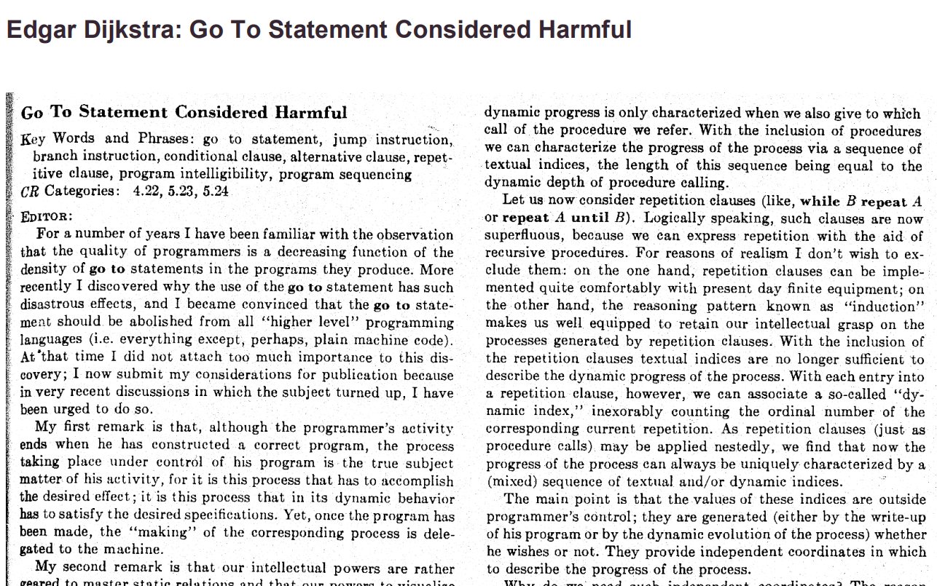

Slide 82
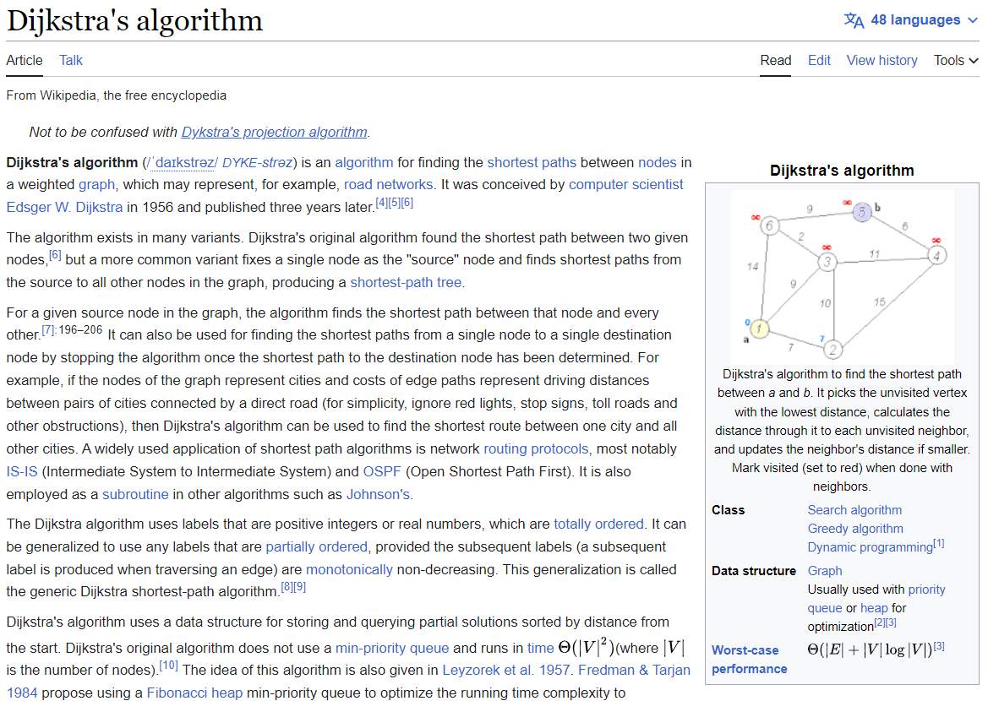

Slide 83
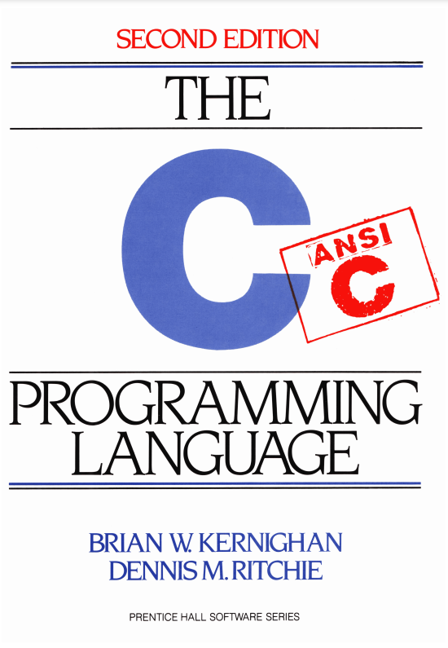

Slide 84
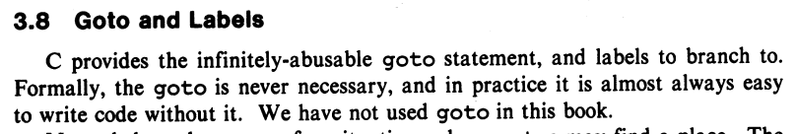
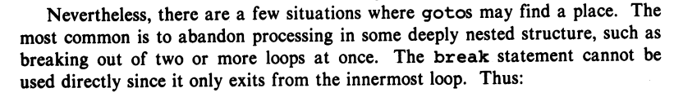
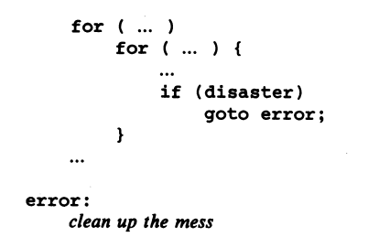

Slide 85
story time ☕️

Slide 86
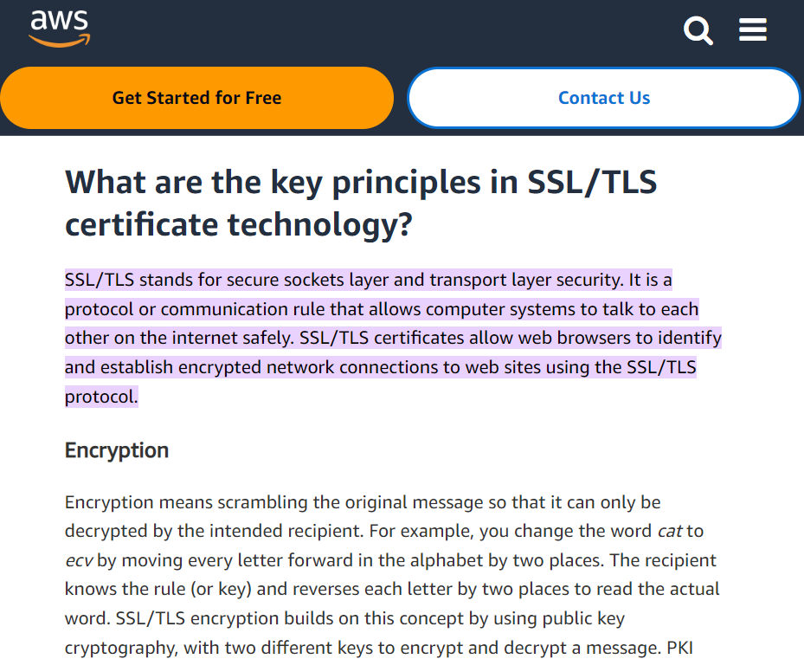

Slide 87
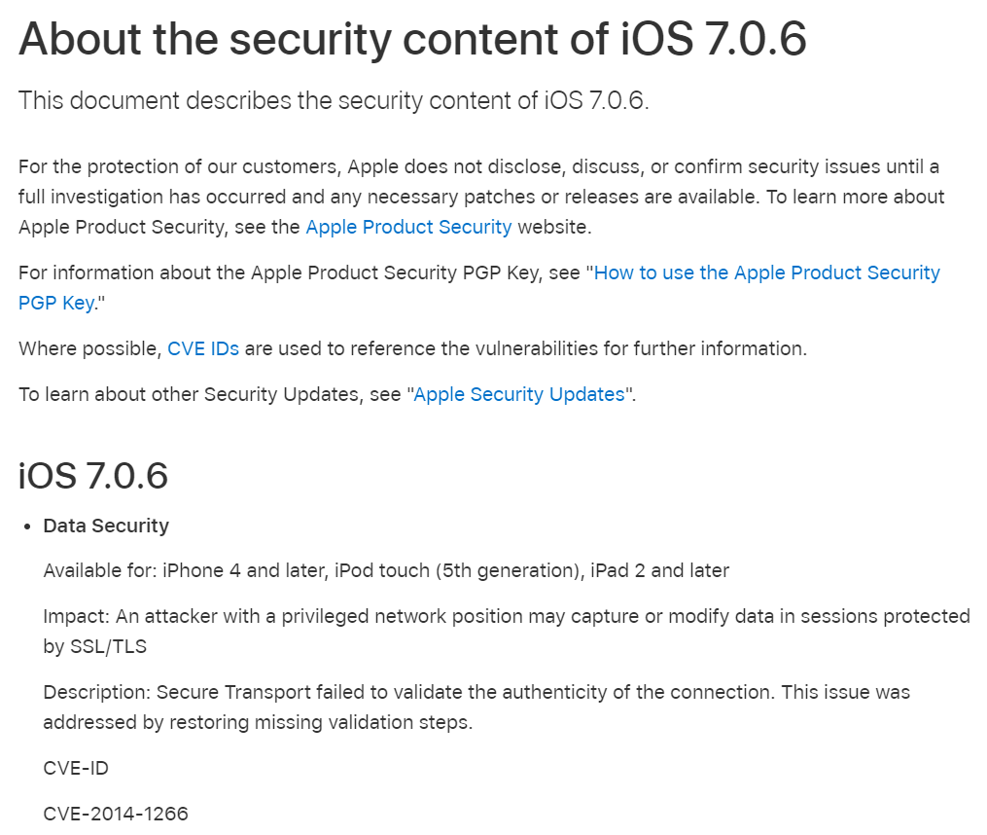

Slide 88
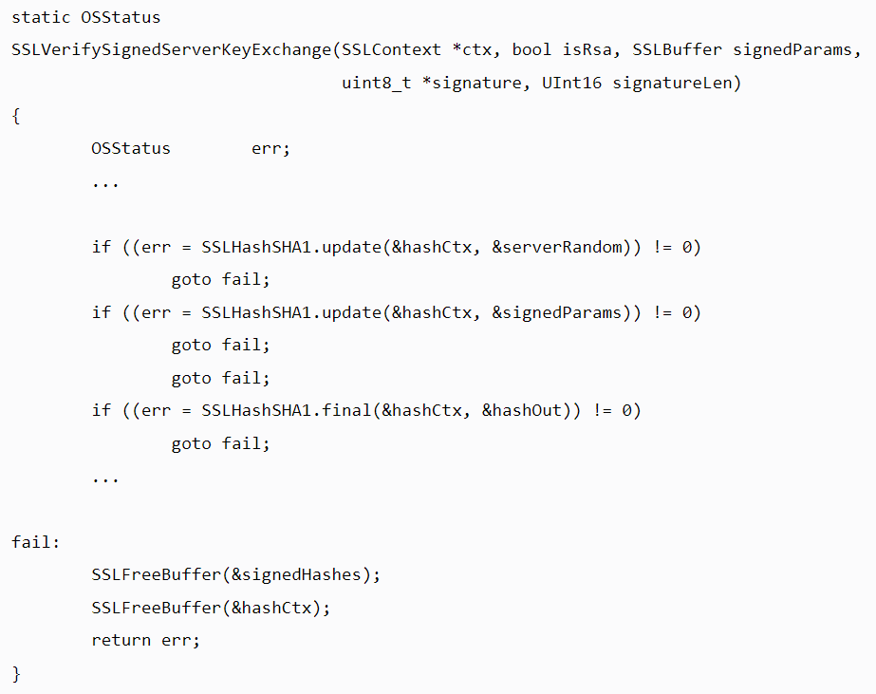

Slide 89
{
}
goto fail;

Slide 90
did the bug really happen because they left out the curly braces?

Slide 91
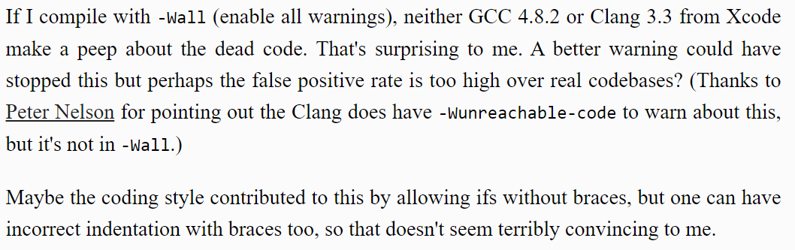

Slide 93
did the bug really happen because they left out the curly braces?

Slide 94
no, the bug happened because they didn't code in DrJava!

Slide 95
highlight your code and press Tab!

Slide 96
big O

Slide 97
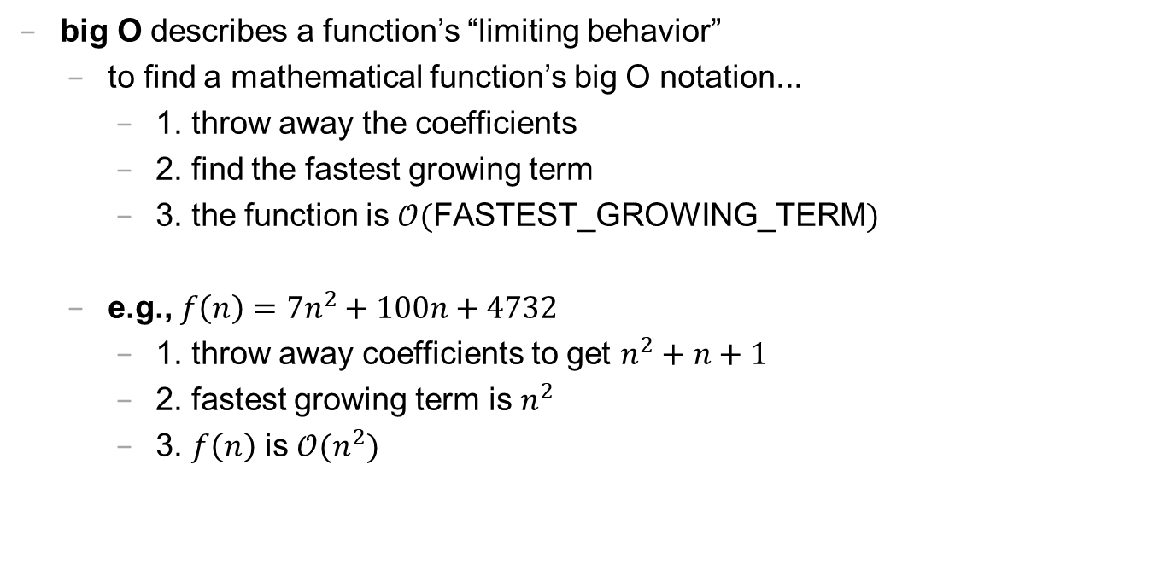
big O (1/2)
big O describes a function’s “limiting behavior”
to find a mathematical function’s big O notation...
1. throw away the coefficients
2. find the fastest growing term
3. the function is $𝒪($FASTEST_GROWING_TERM$)$
e.g., $f\left(n\right)=7n^{2}+100n+4732$
1. throw away coefficients to get $n^{2}+n+1$
2. fastest growing term is $n^{2}$
3. $f\left(n\right)$ is $𝒪(n^{2})$

Slide 98
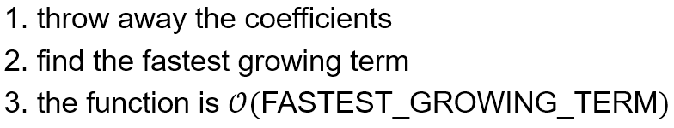
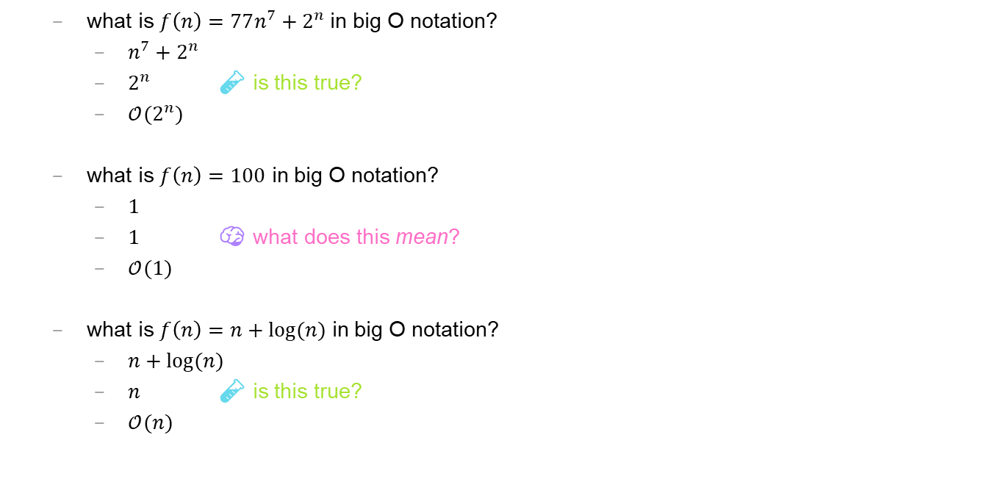
big O (2/2)
what is $f\left(n\right)=77n^{7}+2^{n}$ in big O notation?
$n^{7}+2^{n}$
$2^{n}$ 🧪 is this true?
$𝒪(2^{n})$
what is $f\left(n\right)=100$ in big O notation?
$1$
$1$ 🧠 what does this mean?
$𝒪(1)$
what is $f\left(n\right)=n+log⁡(n)$ in big O notation?
$n+log⁡(n)$
$n$ 🧪 is this true?
$𝒪(n)$

Slide 99
🗣 what is the big O of your isPrime(int n)? can you do better?

Slide 100
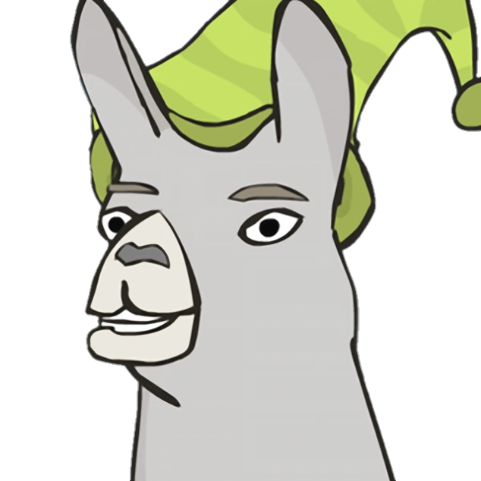
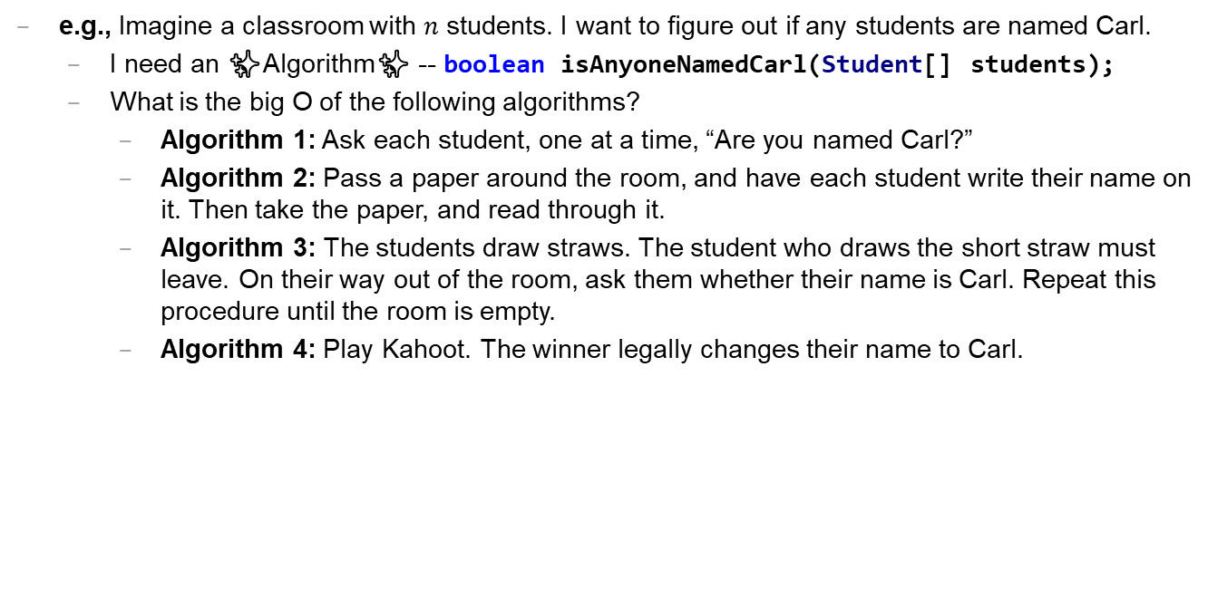
Caaaaaaaaaaaarl
e.g., Imagine a classroom with $n$ students. I want to figure out if any students are named Carl.
I need an ✨Algorithm✨ -- boolean isAnyoneNamedCarl(Student[] students);
What is the big O of the following algorithms?
Algorithm 1: Ask each student, one at a time, “Are you named Carl?”
Algorithm 2: Pass a paper around the room, and have each student write their name on it. Then take the paper, and read through it.
Algorithm 3: The students draw straws. The student who draws the short straw must leave. On their way out of the room, ask them whether their name is Carl. Repeat this procedure until the room is empty.
Algorithm 4: Play Kahoot. The winner legally changes their name to Carl.

Slide 101
extra time: practice exam questions 🤷‍♂️

Slide 102
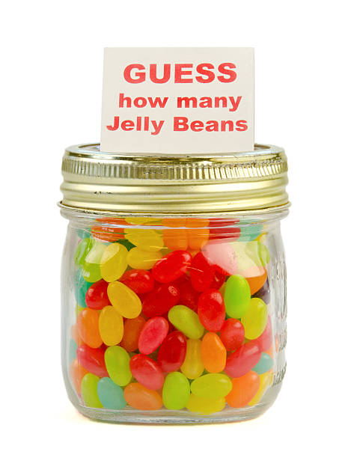
ANNOUNCEMENTS today is No Laptop Monday WARMUP how many arrays does this app use? (answer on Friday) TODAY arrays, aka, The Best Data Structure Ever
arrays

Slide 103
record LEC 02

Slide 104
arrays

Slide 105
mental model of an array

Slide 106
mental model of an array
elements live in equally-sized boxes all right next to each other
🟩🟩🟩🟩🟩🟩🟩🟩
the array itself lives "in memory"

Slide 107

mental model of an array
elements live in equally-sized boxes all right next to each other
🟩🟩🟩🟩🟩🟩🟩🟩
the array itself lives "in memory"

Slide 108
arrays

Slide 109
arrays (1/2)
an array is a fixed-size sequence of elements, all of the same type
"an array of 4372 double's"
"an array of 1 int's"
"an array of 64 Student's"

Slide 110
arrays (2/2)
we will often write an array using curly braces
{ 7, 7, 9 } is an array containing 7, 7, and 9
optionally, you can include a comma after the last element
{ 7, 7, 9, }
☠ even though sets from math also use curly braces, Java arrays have nothing to do with sets; in a set, all elements must be unique

Slide 111
array operations

Slide 112
creating an array (1/2)
you can create an array by specifying its length (the number of elements); if you do, the array is zero-initialized (all elements are initially set to zero)
int[] array = new int[8]; // { 0, 0, 0, 0, 0, 0, 0, 0 }
boolean[] array = new boolean[2]; // { false, false }
String[] array = new String[3]; // { null, null, null }

Slide 113
creating an array (2/2)
you can also create an array by specifying its elements; if you do, the array's length is the number of elements you specified
int[] array = { 7, 7, 9 };
boolean[] array = { true };
String[] array = { "hello", "world" };

Slide 114
getting an array's length
after creating an array, you can get (but not set) its length
int[] array = { 7, 7, 9 };
System.out.println(array.length); // 3
int[] array = new int[8];
System.out.println(array.length); // 8
Error: cannot assign a value to final variable length
array.length = 42;

Slide 115
getting the value of an element of an array
you can get the value of an element of an array using the square brackets and the index of the element
this is also called "accessing the array"
int[] array = { 3, 4, 5 };
int foo = array[0]; // 3
int[] array = { 3, 4, 5 };
int foo = array[42];
java.lang.ArrayIndexOutOfBoundsException: 42

Slide 116
setting the value of an element of an array
you can set the value of an element of an array using the square brackets and the index of the element
int[] array = { 7, 7, 9 };
array[1] = 8;
// { 7, 8, 9 }
int[] array = { 7, 7, 9 };
array[-1] = 1000;
java.lang.ArrayIndexOutOfBoundsException: -1

Slide 117
☠ printing the elements of an array
☠ in Java, you don't simply call System.out.println(array)
instead, you call System.out.println(Arrays.toString(array));
note: this prints with square brackets instead of curly brackets
🤷‍♂️

Slide 118
runtime of array operations

Slide 119
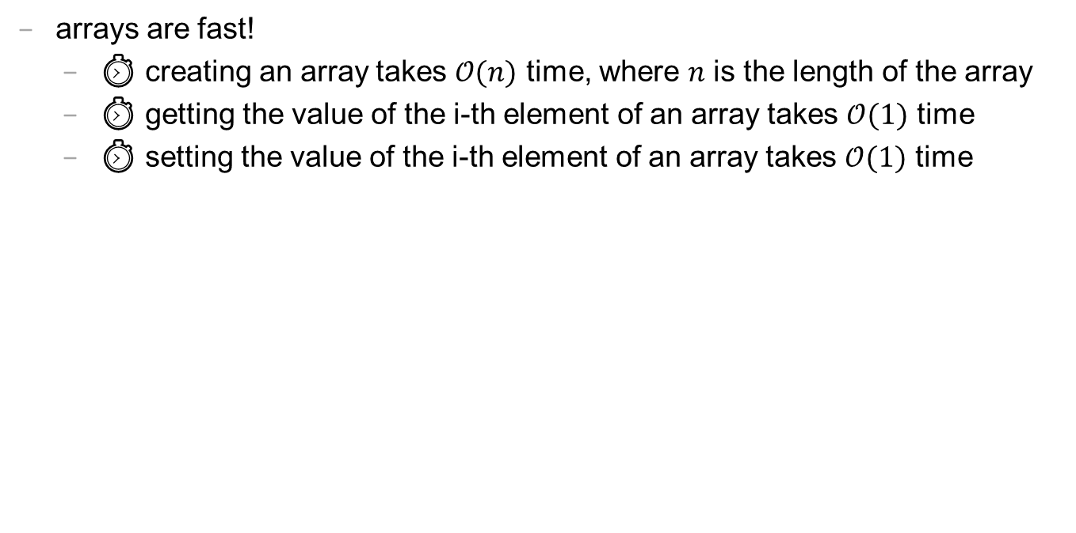
runtime of array operations
arrays are fast!
⏱️ creating an array takes $𝒪(n)$ time, where $n$ is the length of the array
⏱️ getting the value of the i-th element of an array takes $𝒪(1)$ time
⏱️ setting the value of the i-th element of an array takes $𝒪(1)$ time

Slide 120
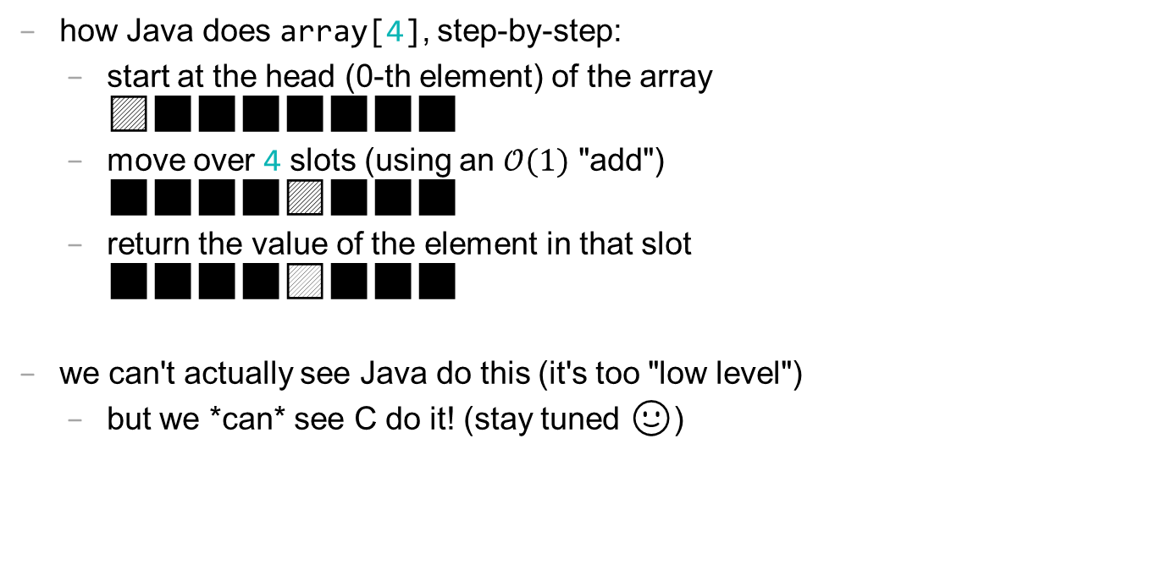
accessing an array "under the hood"
how Java does array[4], step-by-step:
start at the head (0-th element) of the array 🟦⬛⬛⬛⬛⬛⬛⬛
move over 4 slots (using an $𝒪(1)$ "add") ⬛⬛⬛⬛🟦⬛⬛⬛
return the value of the element in that slot ⬛⬛⬛⬛🟨⬛⬛⬛
we can't actually see Java do this (it's too "low level")
but we *can* see C do it! (stay tuned 🙂)

Slide 121
iterating over an array

Slide 122
iterating over an array
a for loop can be used to iterate over an array
for (int i = 0; i < array.length; ++i) {
array[i] = ...;
}

Slide 123
array examples

Slide 124
example: creating an array of the first 100 non-negative integers

Slide 125
example: creating an array of the first 100 non-negative integers
import java.util.*;
class Main {
public static void main(String[] arguments) {
int[] array = new int[100];
for (int i = 0; i < array.length; ++i) {
array[i] = i;
}
System.out.println(Arrays.toString(array));
}
}

Slide 126
example: array copy

Slide 127
example: array copy
import java.util.*;
class Main {
public static void main(String[] arguments) {
int[] source = { 3, 4, 5 };
int[] destination = new int[source.length];
for (int i = 0; i < source.length; ++i) {
destination[i] = source[i];
}
System.out.println(Arrays.toString(source));
System.out.println(Arrays.toString(destination));
}
}

Slide 128
☠ example: bad very bad broken array copy

Slide 129
☠ example: bad very bad broken array copy
import java.util.*;
class Main {
public static void main(String[] arguments) {
int[] source = { 3, 4, 5 };
int[] destination = source;
source[0] = 7;
System.out.println(Arrays.toString(source));
System.out.println(Arrays.toString(destination));
}
}

Slide 130
ANNOUNCEMENTS today is Laptop Wednesday 💻 🎉 WARMUP internally, a String is an array of characters what must stringA + stringB *do*? why might this be scary? 👻
TODAY more arrays; arrays of arrays; arrays arrays arrays

Slide 131
Homework-02 (refresh the page!) 📚

Slide 132
Pre-Lab Post-Lab

Slide 133
record LEC 02

Slide 134
example: circular array

Slide 135
example: circular array
import java.util.*;
class Main {
public static void main(String[] arguments) {
int[] array = new int[5];
int indexToWriteIntoNext = 0;
while (true) {
array[indexToWriteIntoNext] = getIntFromUser();
indexToWriteIntoNext = (indexToWriteIntoNext + 1) % array.length;
System.out.println(Arrays.toString(array));
}
}
static int getIntFromUser() {
Scanner scanner = new Scanner(System.in);
while (!scanner.hasNextInt()) { scanner.nextLine(); }
return scanner.nextInt();
}
}

Slide 136
example: finding the index (and value) of an array's maximum element

Slide 137
example: finding the index (and value) of an array's maximum element
import java.util.*;
class Main {
public static void main(String[] arguments) {
double[] array = { 1.0, 3.0, -42.0, 1000.0, 99.0 };
int indexOfMaximumElement = -1;
double valueOfMaximumElement = Double.NEGATIVE_INFINITY;
for (int i = 0; i < array.length; ++i) {
if (array[i] > valueOfMaximumElement) {
indexOfMaximumElement = i;
valueOfMaximumElement = array[i];
}
}
System.out.println("array[" + indexOfMaximumElement + "] = " + valueOfMaximumElement);
}
}

Slide 138
multi-dimensional arrays

Slide 139
multi-dimensional arrays

Slide 140
multi-dimensional arrays (arrays of arrays of ...)
multi-dimensional arrays are sometimes really handy
int[][] array = { { 3, 4 }, { 5, 6 }, { 7, 8 } };
System.out.println(Arrays.deepToString(array));
// [[3, 4], [5, 6], [7, 8]]
System.out.println(array[0][1]); // 4
int[][][] array = new int[2][3][4];
array[0][0][0] = 42;
System.out.println(Arrays.deepToString(array));
// [[[42, 0, 0, 0], [0, 0, 0, 0], [0, 0, 0, 0]], [[0, 0, 0, 0], [0, 0, 0, 0], [0, 0, 0, 0]]]

Slide 141
swap

Slide 142
🐍 Python swap

Slide 143
🐍 Python swap
a = 0
b = 1
a, b = b, a # Python swap
# a is now 1
# b is now 0

Slide 144
☠️ BAD VERY BAD BROKEN swap

Slide 145
☠️ BAD VERY BAD BROKEN swap
int a = 0;
int b = 1;
{ // BAD VERY BAD BROKEN swap
a = b; // a <- 1
b = a; // b <- 1
}

Slide 146
swap

Slide 147
swap
int a = 0;
int b = 1;
{ // swap
int tmp = a; // tmp <- 0
a = b; // a <- 1
b = tmp; // b <- 0
}

Slide 148
array algorithms that use swaps

Slide 149
reversing an array

Slide 150
out-of-place reverse
we can reverse an array out-of-place using an additional array
static int[] outOfPlaceReverse(int[] array) {
int[] result = new int[array.length];
for (int i = 0; i < array.length; ++i) {
int j = (array.length - 1) - i;
result[i] = array[j];
}
return result;
}

Slide 151
in-place reverse
we can reverse an array in-place using "swaps" (no additional array)
static void inPlaceReverse(int[] array) {
for (int i = 0; i < array.length / 2; ++i) {
int j = (array.length - 1) - i;
int tmp = array[i];
array[i] = array[j];
array[j] = tmp;
}
}

Slide 152
bubble sort

Slide 153
bubble sort
bubble sort is a simple in-place sorting algorithm that uses swaps
import java.util.*;
class Main {
public static void main(String[] arguments) {
int[] array = { 2, 4, 1, 6, 0, 3, 5 };
boolean arrayIsSorted;
do {
arrayIsSorted = true;
for (int i = 0; i < array.length - 1; ++i) {
if (array[i] > array[i + 1]) {
arrayIsSorted = false;
// swap
int tmp = array[i];
array[i] = array[i + 1];
array[i + 1] = tmp;
}
}
} while (!arrayIsSorted);
System.out.println(Arrays.toString(array));
}
}

Slide 154
ANNOUNCEMENTS today is Fun Laptop Friday 💻 🎉
Post-Lab @ 1:00 – 2:00
colloquium @ 2:35; juggling club @ 4:00 WARMUP i finished my paper video (ish)!
let's count the arrays! 🐉
TODAY retry of the array tutorial; live-code; super bugs

Slide 155
how many arrays?
ARRAYS (not counting tiny arrays of 3 double's, which i use to represent points)
NOTE: Counts are very approximate
==========
strings for loading files >5
huge arrays for drawing random stuff (the floor, etc) 2
random stuff in my cow.cpp library (keyboard state, OpenGL objects, etc.) >20
random global variables 1
building the simulation >6
simulation state 3
simulation itself >20
dragon head mesh 7
dragon body mesh 7
dragon mesh 7
sphere mesh 3
cylinder mesh 3
motor configuration 3
arrays that just move data back and forth between C++ <-> unity 8
inverse kinematics >15
physics >10
----------
definitely at least 100; probably less than 1000

Slide 156
💻 array tutorial

Slide 157
💻 array tutorial (this time with a wiki page)

Slide 158
💻 array tutorial
// 🟢 ([5, 4, 7, 0, 0, 7], 7) -> 2
// 🟢 ([5, 4, 7, 0, 0, 7], 3) -> -1
static int findFirstIndexOf(int[] array, int value);
// 🟦 ([1, 3, 3, 2, 3, 4], 3) -> [1, 2, 4]
static int[] removeAllOccurences(int[] array, int value);
// ♦️ [[1, 3], [2, 4, 5], [0, 5]] -> [0, 1, 2, 3, 4, 5, 5]
static int[] mergeArrayOfSortedArrays(int[][] arrays);

Slide 159
record LEC 02

Slide 160
attempt to live-code the solutions while half-asleep 🙂👍

Slide 161
☕️ the art of coding things in the right order compile and run early, compile and run often

Slide 162
why implement Rule 22 first? why not just skip straight to the general case?

Slide 163

well, let us imagine...

Slide 164
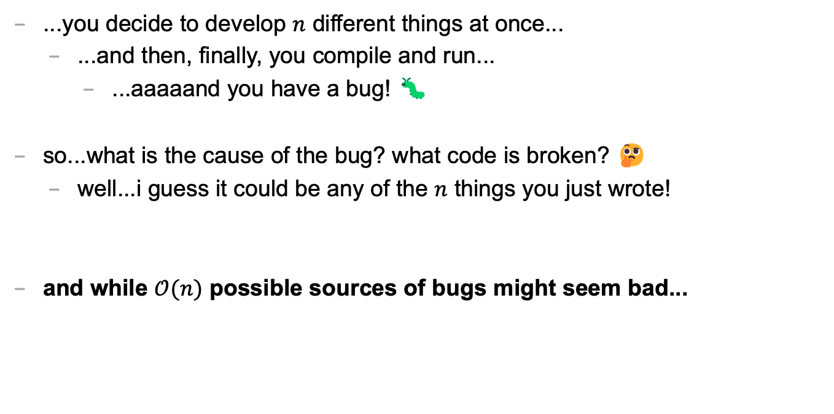
let's imagine...
...you decide to develop $n$ different things at once...
...and then, finally, you compile and run...
...aaaaand you have a bug! 🐛
so...what is the cause of the bug? what code is broken? 🤔
well...i guess it could be any of the $n$ things you just wrote!
and while $𝒪(n)$ possible sources of bugs might seem bad...

Slide 165
...the reality is ✨so much worse✨!

Slide 166

because broken code likes to interact with other broken code, to make✨super bugs✨!

Slide 168
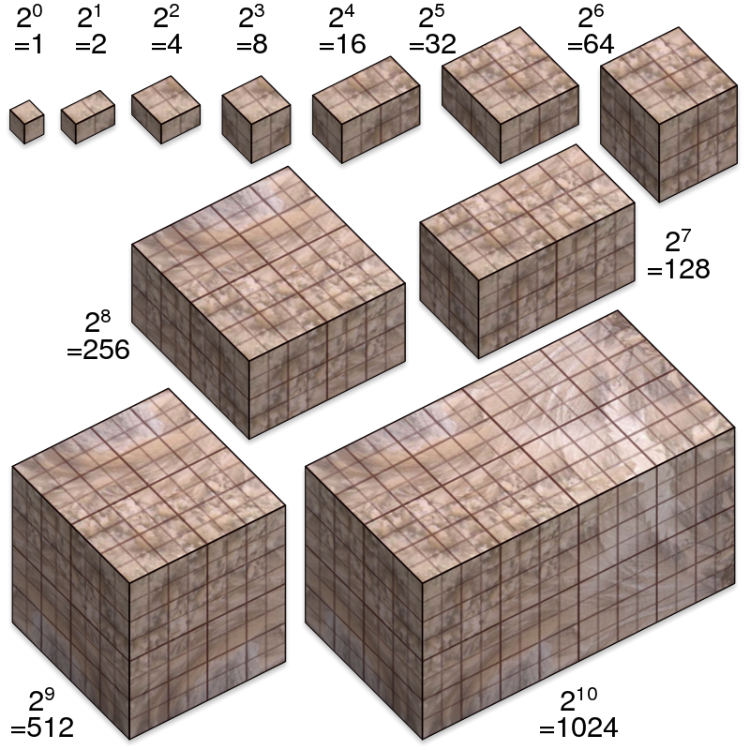
not broken
broken
developing one thing at a time

Slide 169
not broken
A is broken
B is broken
A and B are both broken
developing two things at a time

Slide 170

asymptotic bug-finding time

Slide 171
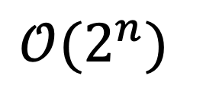
$$𝒪(2^{n})$$
gl;hf 🙂👍

Slide 172
big lesson
implement code one thing at a time
compile and run and test after implementing every single thing
this is a learned skill!
how i would actually implement the automata homework
make the array
print the array as an array
print the array as a string
update the array once using Rule 22 and print the result
wrap the printing and update in a for loop
implement code to handle all rules and test it on Rule 22
test it on the other rules

Slide 173
this is a learned skill!

Slide 174

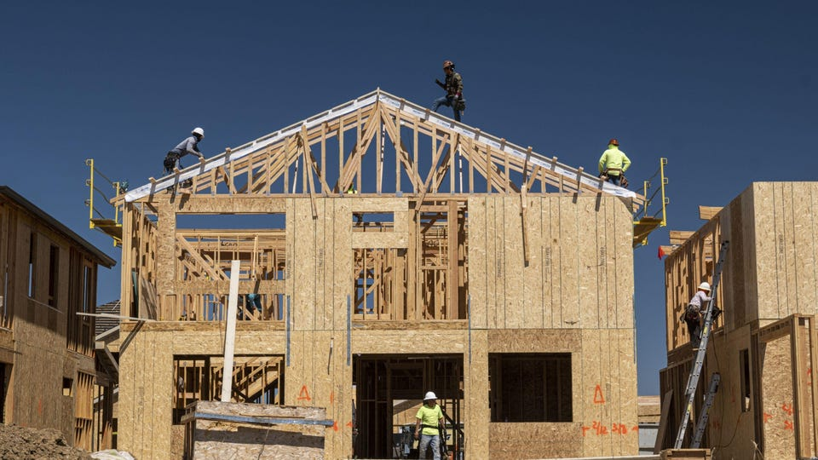
in summary

Slide 175
extra time: practice exam questions 🤷‍♂️

Slide 177
do problems from last time

Slide 178
arrays in C

Slide 179
keep it simple and use array

Slide 181
ANNOUNCEMENTS today is No Laptop Monday! WARMUP what is a 3, 4, 5 right triangle (from geometry)?
what are points and vectors (from geometry)?
why would you write a function?
why would you write a class?
TODAY a very class-y lecture lol

Slide 182
draw some points and lines on the board

Slide 183
monday memes

Slide 184
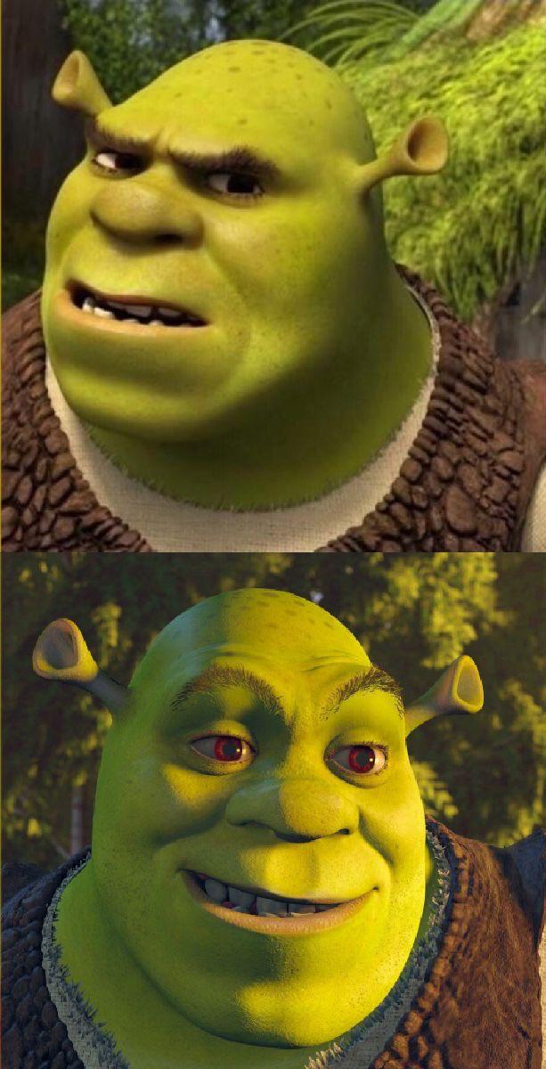
code up the entire program without compiling it
compile early; compile often

Slide 185

compilers

Slide 186
record LEC 01

Slide 187
functions

Slide 188
anatomy of a function

Slide 189
anatomy of a function (1/2)
a function is a lil chunk of code you can call from elsewhere
a function takes any number of arguments
... foo(int arg) { ... } // function foo takes an int
a function with a non-void return type must return a value of that type
int bar(...) { ... } // bar returns an int
void baz(...) { ... } // baz doesn't return anything
ReturnType functionName(ArgumentOneType argumentOne, ...) {
...
}

Slide 190
anatomy of a function (2/2)
void drawLine(Vector2 pointA, Vector2 pointB, Vector3 color) {
...
}

Slide 191
function arguments

Slide 192
arguments
a function can take arguments

Slide 193
return

Slide 194
return (1/2)
a return statement stops execution of a function and returns the program to where the function was called
some return statements return a value
return 123;
others do not
return;

Slide 195
return (2/2)
a function with a non-void return type must return a value of that type, regardless of the path taken through the function
Error: missing return statement
static boolean isPrime(int n) {
if (n <= 1) { return false; }
for (int i = 2; i <= Math.sqrt(n); ++i) {
if (n % i == 0) { return false; }
}
}

Slide 196
return (2/2)
a function with a non-void return type must return a value of that type, regardless of the path taken through the function
static boolean isPrime(int n) {
if (n <= 1) { return false; }
for (int i = 2; i <= Math.sqrt(n); ++i) {
if (n % i == 0) { return false; }
}
return true;
}

Slide 197
void

Slide 198
void
void is a special return type meaning a function does not return a value
void functions often modify (the objects referenced by) their arguments
static void reverseArrayInPlace(int[] array) { ... }
// no need to return a reference to array // (user of the function already has one)
in Java, the main method is a void function
public static void main(String[] arguments) { ... }

Slide 199
the call stack

Slide 200
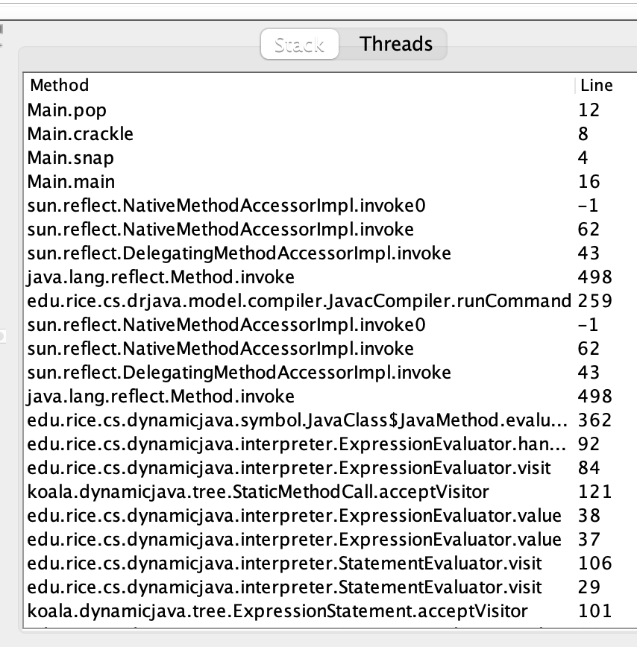
the call stack
functions can call other functions
the resulting "stack" of function calls is called the call stack
class Main {
static void snap() {
crackle();
}
static void crackle() {
pop();
}
static void pop() {
return;
}
public static void main(String[] arguments) {
snap();
}
}

Slide 201
🤔

Slide 202
recursion

Slide 203
recursion (1/2)
a recursive function is a function that calls itself
each call must make progress towards a base case (when the function finally returns without calling itself)
✨ when in doubt, try something like zero for your base case
class Main {
static int digitSum(int n) {
if (n == 0) {
return 0;
}
return digitSum(n / 10) + (n % 10);
}
public static void main(String[] arguments) {
System.out.println(digitSum(256)); // 13
}
}

Slide 204
static int digitSum(int n) {
if (n == 0) {
return 0;
}
return digitSum(n / 10) + (n % 10);
}
return 0;
return digitSum(0) + 2;
return digitSum(2) + 5;
return digitSum(25) + 6;
int a = digitSum(256);

Slide 205
static int digitSum(int n) {
if (n == 0) {
return 0;
}
return digitSum(n / 10) + (n % 10);
}
return 0;
return digitSum(0) + 2;
return digitSum(2) + 5;
return digitSum(25) + 6;
int a = digitSum(256);

Slide 206
static int digitSum(int n) {
if (n == 0) {
return 0;
}
return digitSum(n / 10) + (n % 10);
}
return 0 + 2;
return digitSum(2) + 5;
return digitSum(25) + 6;
int a = digitSum(256);

Slide 207
static int digitSum(int n) {
if (n == 0) {
return 0;
}
return digitSum(n / 10) + (n % 10);
}
return 2;
return digitSum(2) + 5;
return digitSum(25) + 6;
int a = digitSum(256);

Slide 208
static int digitSum(int n) {
if (n == 0) {
return 0;
}
return digitSum(n / 10) + (n % 10);
}
return 2;
return digitSum(2) + 5;
return digitSum(25) + 6;
int a = digitSum(256);

Slide 209
static int digitSum(int n) {
if (n == 0) {
return 0;
}
return digitSum(n / 10) + (n % 10);
}
return 2 + 5;
return digitSum(25) + 6;
int a = digitSum(256);

Slide 210
static int digitSum(int n) {
if (n == 0) {
return 0;
}
return digitSum(n / 10) + (n % 10);
}
return 7;
return digitSum(25) + 6;
int a = digitSum(256);

Slide 211
static int digitSum(int n) {
if (n == 0) {
return 0;
}
return digitSum(n / 10) + (n % 10);
}
return 7;
return digitSum(25) + 6;
int a = digitSum(256);

Slide 212
static int digitSum(int n) {
if (n == 0) {
return 0;
}
return digitSum(n / 10) + (n % 10);
}
return 7 + 6;
int a = digitSum(256);

Slide 213
static int digitSum(int n) {
if (n == 0) {
return 0;
}
return digitSum(n / 10) + (n % 10);
}
return 13;
int a = digitSum(256);

Slide 214
static int digitSum(int n) {
if (n == 0) {
return 0;
}
return digitSum(n / 10) + (n % 10);
}
return 13;
int a = digitSum(256);

Slide 215
static int digitSum(int n) {
if (n == 0) {
return 0;
}
return digitSum(n / 10) + (n % 10);
}
int a = 13;

Slide 216
fin.

Slide 217
recursion (2/2)
a stack overflow error happens when functions call too many functions without returning; these errors are usually caused by broken recursive code
class Main {
static void stackOverflow() {
stackOverflow();
}
public static void main(String[] arguments) {
stackOverflow();
}
}
java.lang.StackOverflowError
at Main.stackOverflow(Tmp.java:3)
at Main.stackOverflow(Tmp.java:3)
at Main.stackOverflow(Tmp.java:3)
at Main.stackOverflow(Tmp.java:3)
at Main.stackOverflow(Tmp.java:3)
at Main.stackOverflow(Tmp.java:3)
at Main.stackOverflow(Tmp.java:3)
at Main.stackOverflow(Tmp.java:3)
at Main.stackOverflow(Tmp.java:3)
at Main.stackOverflow(Tmp.java:3)
at Main.stackOverflow(Tmp.java:3)
at Main.stackOverflow(Tmp.java:3)
at Main.stackOverflow(Tmp.java:3)
at Main.stackOverflow(Tmp.java:3)
at Main.stackOverflow(Tmp.java:3)
at Main.stackOverflow(Tmp.java:3)
at Main.stackOverflow(Tmp.java:3)
at Main.stackOverflow(Tmp.java:3)
at Main.stackOverflow(Tmp.java:3)
at Main.stackOverflow(Tmp.java:3)
at Main.stackOverflow(Tmp.java:3)
at Main.stackOverflow(Tmp.java:3)
at Main.stackOverflow(Tmp.java:3)
at Main.stackOverflow(Tmp.java:3)
at Main.stackOverflow(Tmp.java:3)
at Main.stackOverflow(Tmp.java:3)
at Main.stackOverflow(Tmp.java:3)
at Main.stackOverflow(Tmp.java:3)
at Main.stackOverflow(Tmp.java:3)
at Main.stackOverflow(Tmp.java:3)
at Main.stackOverflow(Tmp.java:3)
at Main.stackOverflow(Tmp.java:3)
at Main.stackOverflow(Tmp.java:3)
at Main.stackOverflow(Tmp.java:3)
at Main.stackOverflow(Tmp.java:3)
at Main.stackOverflow(Tmp.java:3)
at Main.stackOverflow(Tmp.java:3)
at Main.stackOverflow(Tmp.java:3)
at Main.stackOverflow(Tmp.java:3)
at Main.stackOverflow(Tmp.java:3)
at Main.stackOverflow(Tmp.java:3)
at Main.stackOverflow(Tmp.java:3)
at Main.stackOverflow(Tmp.java:3)
at Main.stackOverflow(Tmp.java:3)
at Main.stackOverflow(Tmp.java:3)
at Main.stackOverflow(Tmp.java:3)
at Main.stackOverflow(Tmp.java:3)
at Main.stackOverflow(Tmp.java:3)
at Main.stackOverflow(Tmp.java:3)
at Main.stackOverflow(Tmp.java:3)
at Main.stackOverflow(Tmp.java:3)
at Main.stackOverflow(Tmp.java:3)
at Main.stackOverflow(Tmp.java:3)
at Main.stackOverflow(Tmp.java:3)
at Main.stackOverflow(Tmp.java:3)
at Main.stackOverflow(Tmp.java:3)
at Main.stackOverflow(Tmp.java:3)
at Main.stackOverflow(Tmp.java:3)
at Main.stackOverflow(Tmp.java:3)
at Main.stackOverflow(Tmp.java:3)
at Main.stackOverflow(Tmp.java:3)
at Main.stackOverflow(Tmp.java:3)
at Main.stackOverflow(Tmp.java:3)
at Main.stackOverflow(Tmp.java:3)
at Main.stackOverflow(Tmp.java:3)
at Main.stackOverflow(Tmp.java:3)

Slide 218
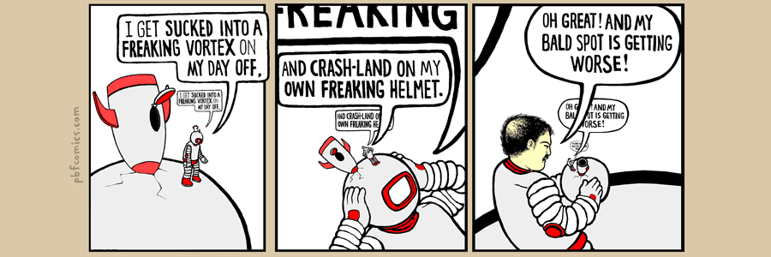

Slide 219
classes

Slide 220
anatomy of a class

Slide 221
anatomy of a class (1/2)
class ClassName {
VariableOneType variableOne;
...
FunctionOneReturnType functionOneName(...) { ... }
...
}
a class is (a blueprint for) a lil chunk of data that you can make elsewhere
a class may have any number of variables (fields)
int foo; // objects of this class have an int called foo
a class may have any number of functions (methods)
int bar() { ... } // objects of class have function bar

Slide 222
anatomy of a class (2/2)
class Vector2 {
// instance variables
double x;
double y;
// constructor
Vector2(double x, double y) { ... }
// instance methods
double length() { ... }
...
}

Slide 223
dot

Slide 224
dot
the dot operator is used to access an object's variables and functions
Vector2 a = new Vector2();
a.x = 3.0;
a.y = 4.0;
System.out.println(a.length()); // 5.0

Slide 225
terminology

Slide 226
class vs. object (instance of a class)
a class is NOT the same thing as an object
a class is "a blueprint for making objects"
we can make an instance of a class (an object) using the new keyword
this is called "instantiating the class"

Slide 227
new and constructors

Slide 228
new
the new keyword create a new instance of a class and calls its appropriate constructor
int[] array = new int[5]; // { 0, 0, 0, 0, 0 }
Vector2 a = new Vector2(3.0, 4.0); // (3.0, 4.0)
☠️ you don't need new to create a new string
String string = "strings are their own thing";
☠️ new doesn't actually return the object it created; it returns a reference to the object it created

Slide 229
constructors (1/2)
a constructor is called when an object is created
if the class does not have a constructor, then the default constructor must be called, which takes no arguments and sets all variables to zero
Vector2 a = new Vector2(3.0, 4.0); // (3.0, 4.0)
Vector2 b = new Vector2(); // (0.0, 0.0)

Slide 230
constructors (2/2)
a (non-default) constructor is never necessary, but is often convenient
Vector2 a = new Vector2(3.0, 4.0); // a: (3.0, 4.0)
Vector2 a = new Vector2(); // a: (0.0, 0.0)
a.x = 3.0; // a: (3.0, 0.0)
a.y = 4.0; // a: (3.0, 4.0)

Slide 231
this

Slide 232
this (1/2)
this is a reference to the instance of the class whose function we're inside of
class Vector2 {
double x;
double y;
Vector2(double x, double y) {
this.x = x;
this.y = y;
}
Vector2 plus(Vector2 other) {
return new Vector2(this.x + other.x, this.y + other.y);
}
...
}

Slide 233
this (2/2)
this is especially useful inside a constructor (elsewhere it's usually optional)
class Vector2 {
double x;
double y;
Vector2(double x, double y) {
this.x = x;
this.y = y;
}
Vector2 plus(Vector2 other) {
return new Vector2(x + other.x, y + other.y);
}
...
}

Slide 234
TODO: next lecture starts here

Slide 235
Java memory model (references to objects)

Slide 236
references and null

Slide 237
references (1/2)
in Java, we deal with references to objects
int[] foo; // foo is a reference to an int array
String bar; // bar is a reference to a String object
Vector2 a; // a is a reference to a Vector2 object

Slide 238
references (2/2)
☠️ you can (unintentionally) make multiple reference to one object
Vector2 a = new Vector2(3.0, 4.0);
Vector2 b = a;
// a and b are references to the same Vector2 object!
a
x
y
3.0
4.0
b

Slide 239
null
a null reference doesn't refer to any object
Vector2[] array = new Vector2[3]; // { null, null, null }
Vector2 a = null;

Slide 240
TODO: WATCH JONNY MNEMONIC

Slide 241
the heap a reference is a memory address a memory address is an integer

Slide 242
the heap
objects made using new are stored "on the heap"
the heap is a huuuuuge chunk of memory
objects have an address in that memory (that says where they live)
0x00110022
0x00a20038
0x0ff0a147

Slide 244
Vector2 a = new Vector2(3.0, 4.0);
a
0x00000008
3.0
4.0
0x00000000
0x00000003
0x00000013
0x00000001
0x00000002
0x00000010
0x00000011
0x00000004
0x00000007
0x0000000b
0x00000012
0x00000005
0x00000006
0x00000008
0x00000009
0x0000000a
0x00000014
0x0000000c
0x0000000f
0x00000015
0x0000000d
0x00000008
0x0000000e

Slide 245
references (1/2)
= assigns the value on the right-hand side to the variable on the left-hand side
int a = 3;
int b = a;
a
b
3
3

Slide 246
references (1/2)
= assigns the value on the right-hand side to the variable on the left-hand side
int a = 3;
int b = a;
a = 7;
a
b
7
3

Slide 247
references (2/2)
int a = 3;
int b = a;
a
b
☠️ new doesn't actually return the object it created; it returns a reference to the object it created
a reference is an object's location in memory
this reference is a number (it acts like an int)!
3
3
Foo a = new Foo();
Foo b = a;
a
b
0x7aae6227
0x7aae6227
0x7aae6227

Slide 248
references (3/2)
i told a small lie last time we talked
System.out.println(array); does NOT actually print array's memory address
rather, it prints a number called array's "hash code"
(the hash code is typically calculated using the memory address)
🤷
the important point is that a reference is a memory address
and a memory address is an integer (often written in hex) 🙂👍

Slide 249
static

Slide 250
static variables and static methods

Slide 251
instance variables vs. static variables
an instance variable is part of an instance of a class
a static variable (class variable) is part of the class itself
there is only one, period.
class Vector3 {
static Vector3 red = new Vector3(1.0, 0.0, 0.0);
...
}
// drawLine(a, b, Vector3.red);

Slide 252
instance methods vs. static methods
an instance method must be called on an instance (object) of a class
a static method (class method) can be called on the class itself
✅ there is no this in a static method
class Vector2 {
double length() { ... }; // (non-static method)
static double distanceBetween(Vector2 a, Vector2 b) { ... }
...
}
// a.length();
// Vector2.distanceBetween(a, b);

Slide 253
example

Slide 254
class Dog {
String bark;
Dog(String bark) {
this.bark = bark;
}
void makeBark() {
System.out.println(this.bark);
Dog.numBarks++;
}
static int numBarks;
> public static void main(String[] args) {
Dog rex = new Dog("woof!");
> Dog fido = new Dog("yip!");
rex.makeBark();
fido.makeBark();
System.out.println(Dog.numBarks);
}
}
Dog
(the class)
args
(an instance/object of String[])
int numBarks;
rex
(an instance of Dog)
rex.bark
(an instance of String)
String bark;
"woof!"
String[] args;
Dog rex;
Dog fido;
fido
(an instance of Dog)
fido.bark
(an instance of String)
main()
(stack frame)
String bark;
"yip!"
(these are references!)
----Stack----
(local variables)
-------Heap-------
(instances aka objects)
-----Static-----
(static data)

Slide 255
object-oriented programming

Slide 256
in Java, everything is a class

Slide 257
object-orientation != my-code-has-objects

Slide 258
compression-oriented programming

Slide 259
neo in the matrix (int) int a; int b

Slide 260
details

Slide 261
garbage collection

Slide 262
garbage collector
the garbage collector is like a trash truck that drives around in memory; when it notices an object that your program no longer has any references to, it frees up that memory for future use
🌊 C does NOT have a garbage collector; in C you free heap-allocated memory yourself by calling free(...)

Slide 263
array list

Slide 264
motivation

Slide 265
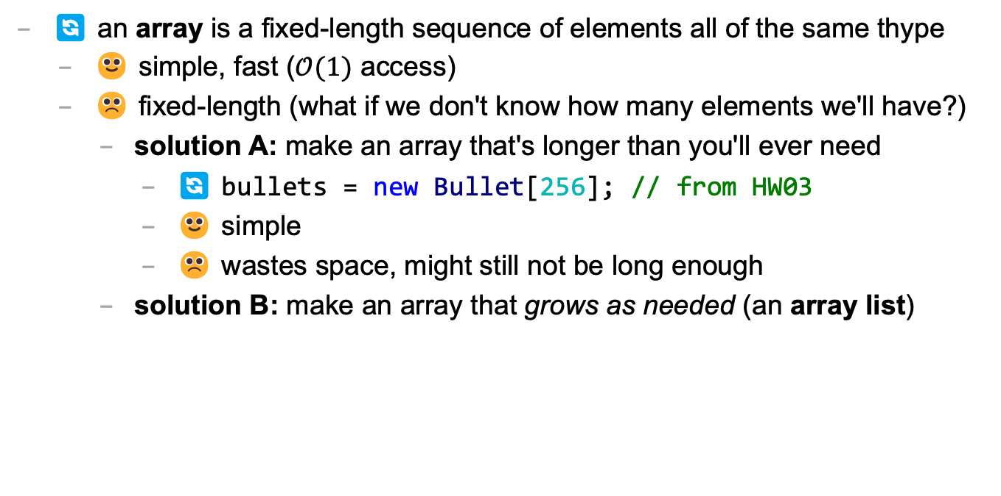
arrays are fixed-length
🔄 an array is a fixed-length sequence of elements all of the same thype
🙂 simple, fast ($𝒪(1)$ access)
☹️ fixed-length (what if we don't know how many elements we'll have?)
solution A: make an array that's longer than you'll ever need
🔄 bullets = new Bullet[256]; // from HW03
🙂 simple
☹️ wastes space, might still not be long enough
solution B: make an array that grows as needed (an array list)

Slide 266
let's start by taking a step back and ask "what is a list?"

Slide 267
terminology

Slide 268
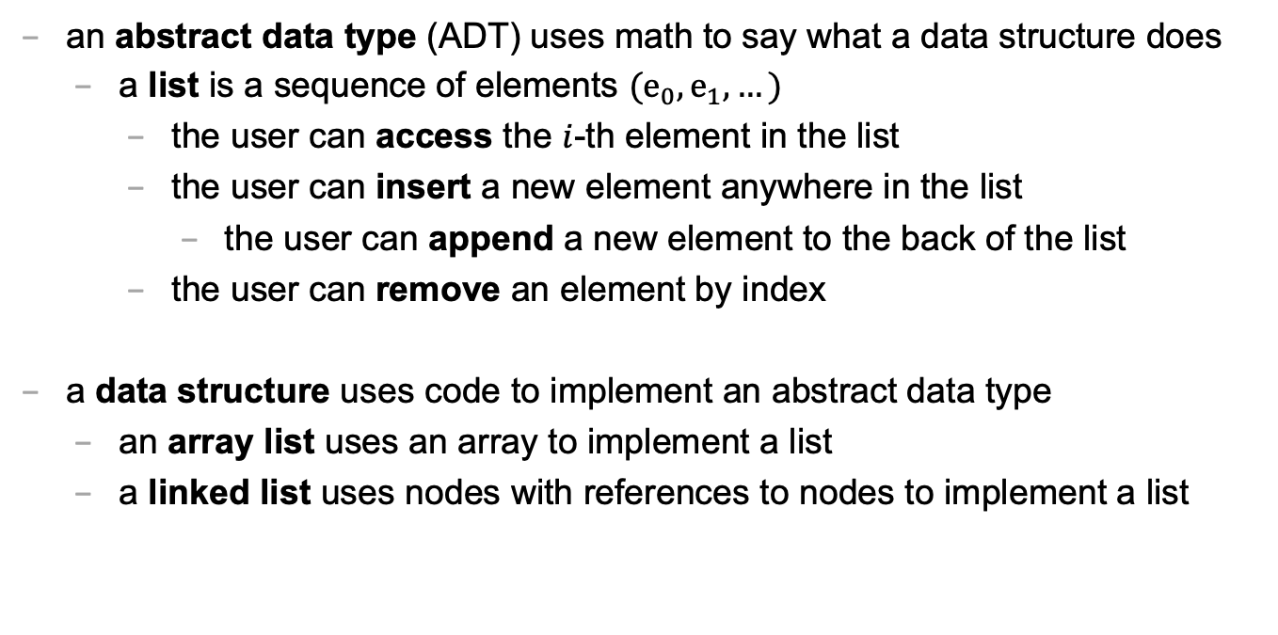
abstract data type vs. data structure
an abstract data type (ADT) uses math to say what a data structure does
a list is a sequence of elements $(e_{0},e_{1},…)$
the user can access the $i$-th element in the list
the user can insert a new element anywhere in the list
the user can append a new element to the back of the list
the user can remove an element by index
a data structure uses code to implement an abstract data type
an array list uses an array to implement a list
a linked list uses nodes with references to nodes to implement a list

Slide 269
list

Slide 270
list
a list (sequence) is our first "abstract data type"
abstract data type means
🐍 Python's list is an example of a list

Slide 271
array list
the array list (dynamic array, stretchy buffer, vector) data structure uses an array to implement a list
an array list's length is the number of elements stored inside it
an array list stores its elements inside of an array
i call this array the array list’s “internal array”
an array list's capacity is the length of this internal array

Slide 272
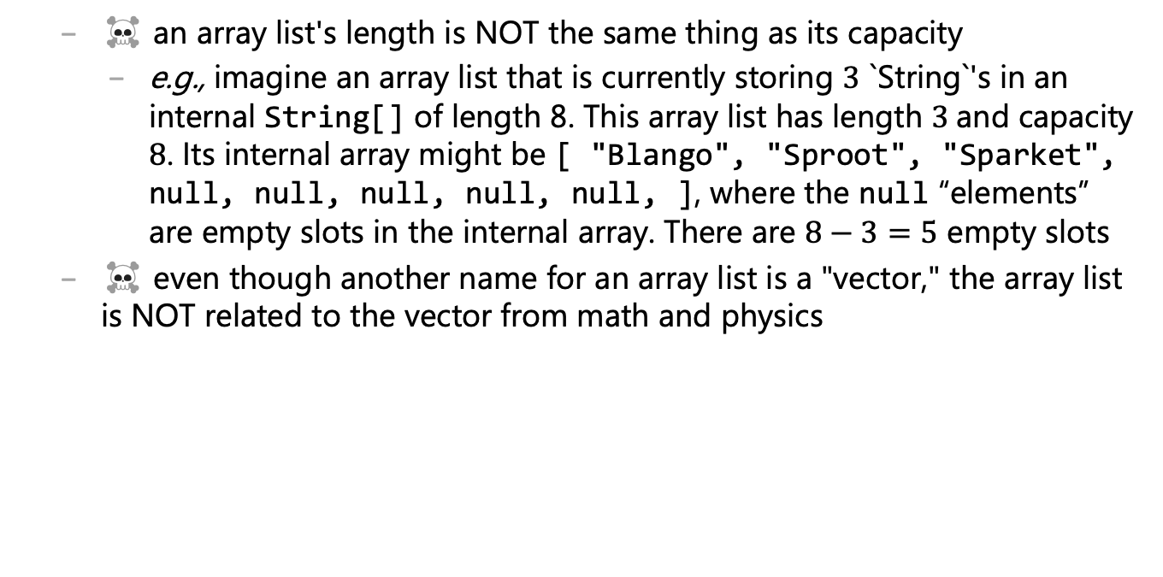
array list
☠️ an array list's length is NOT the same thing as its capacity
e.g., imagine an array list that is currently storing $3$ `String`'s in an internal String[] of length 8. This array list has length $3$and capacity $8$. Its internal array might be [ "Blango", "Sproot", "Sparket", null, null, null, null, null, ], where the null “elements” are empty slots in the internal array. There are $8−3=5$ empty slots
☠️ even though another name for an array list is a "vector," the array list is NOT related to the vector from math and physics

Slide 273
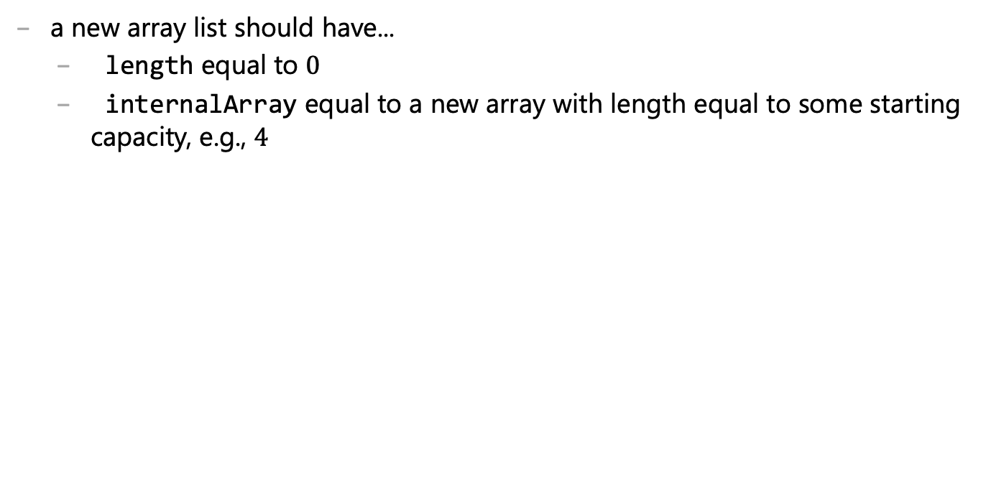
ArrayList() { ... }
a new array list should have...
length equal to $0$
internalArray equal to a new array with length equal to some starting capacity, e.g., $4$

Slide 274
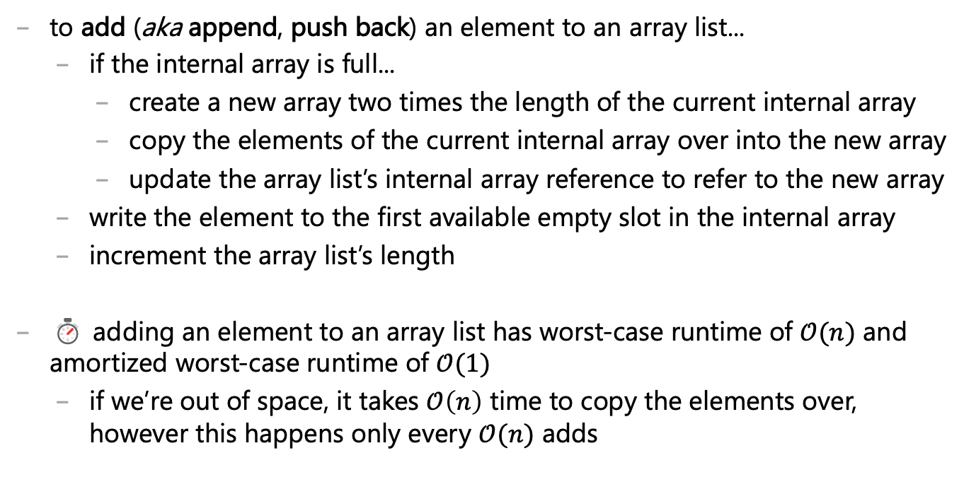
void add(ElementType element) { ... }
to add (aka append, push back) an element to an array list...
if the internal array is full...
create a new array two times the length of the current internal array
copy the elements of the current internal array over into the new array
update the array list’s internal array reference to refer to the new array
write the element to the first available empty slot in the internal array
i ncrement the array list’s length
⏱ adding an element to an array list has worst-case runtime of $𝒪(n)$ and amortized worst-case runtime of $𝒪(1)$
if we’re out of space, it takes $𝒪\left(n\right)$ time to copy the elements over, however this happens only every $𝒪(n)$ adds

Slide 276
about the lectures

Slide 277
🐮 how to read side by side code
i often show equivalent code side by side in order to...
relate new concepts to old concepts
compare and contrast different design decisions, e.g.,
a piece of code | equivalent code | equivalent code | equivalent code
boolean isEven; if (i % 2 == 0) { isEven = true; } else if (i % 2 != 0) { isEven = false; } if (isEven) { ... } | boolean isEven; if (i % 2 == 0) { isEven = true; } else { isEven = false; } if (isEven) { ... } | boolean isEven = (i % 2 == 0); if (isEven) { ... } | if (i % 2 == 0) { ... }

Slide 278
🐮 how to read emojis
i use emojis to help you read and study
🐮 info only relevant inside the world of CS136
☕ fun Java fact! (i.e., NOT relevant to C/C++; please forget after CS136)
🐍 comparison to Python
☠ common misconception or potential source of bugs
👀 spoilers/hints
⏱ big O runtime
✨ optional (NOT on exams) but sparks joy
🧠 question for you to think about
🗣️ question for your to talk about
🧪 question for you to experiment with
🙂👍

Slide 279
🐮 how to read a step-by-step diff?
to show you the step-by-step process by which i write code, i will use something called a diff, which shows us the “difference” between two files
i will basically always be diffing the code at the current step with the code at the previous step, i.e.,
+ this line of code was just added - this line of code was just deleted this line of code was here last step and is still here now

